Slide 1

More sustainable and effective solutions

Slide 2



DEVICES CONTROL
Leave the technology to us

Slide 3
About us
Alshabka for Control Devices is a leading company in the field of automation in the United Arab Emirates. We offer a wide range of energy-saving, environmentally friendly devices and solutions.
The responsibility of Alshabka for Control Devices lies in ensuring efficient operation throughout the life cycle of the building and preserving the resources of our environment. With the modern systems we provide that keep pace with technological envelopment, as well as the quality of services provided under the supervision of the most skilled specialists.

Slide 4
Our energy management system provides sustainable energy data management, saves a lot of wasted consumption, and empowers people to be environmental protectors to create a better future Our smart solutions enable small and medium-sized companies to save a lot in operational budgets. Alshabka for control devices is one of the leading companies in UAE involved in fields of electrical, construction, maintenance, contracting and specialized in control electromechanics and electric control devices

Slide 5
Our organization
We have a fully trained team of experienced technical staff comprising of Engineers, Supervisors, Electricians, & Semi-skilled workers. Teamwork of all achieves the project completion in time and compliance with agreed standard & specifications.

Slide 6


Slide 7
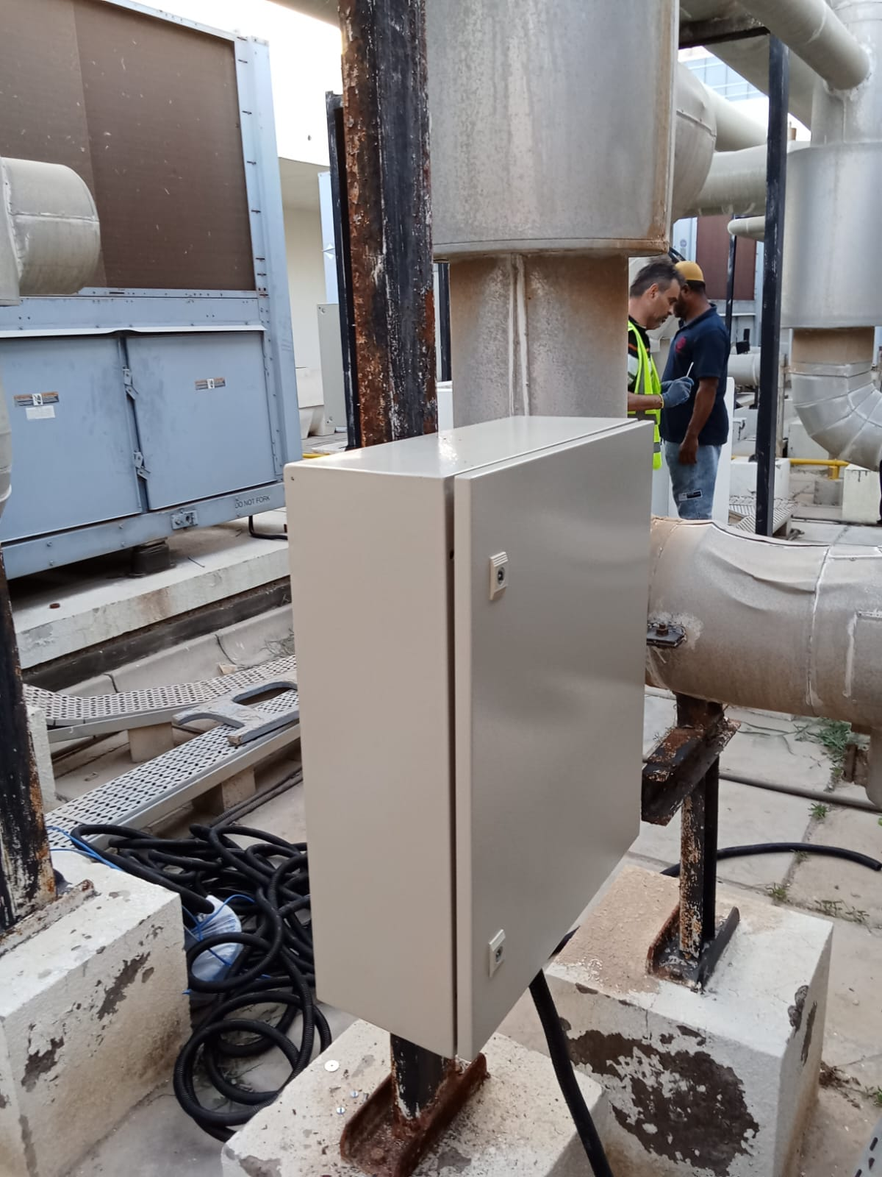
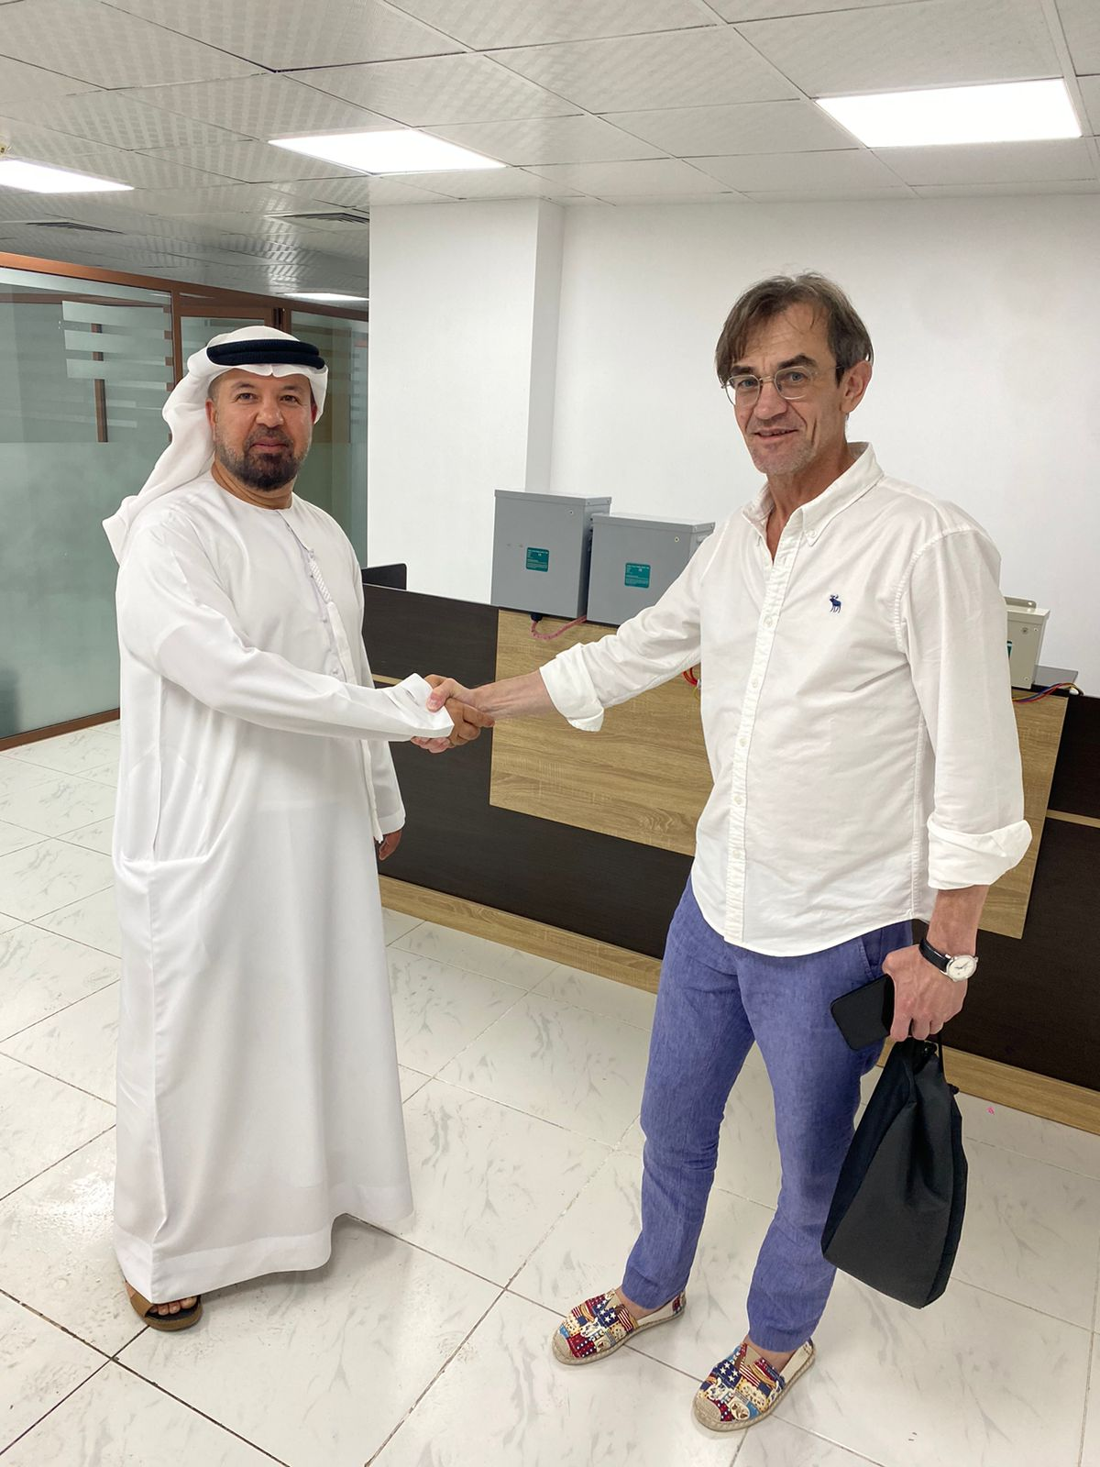
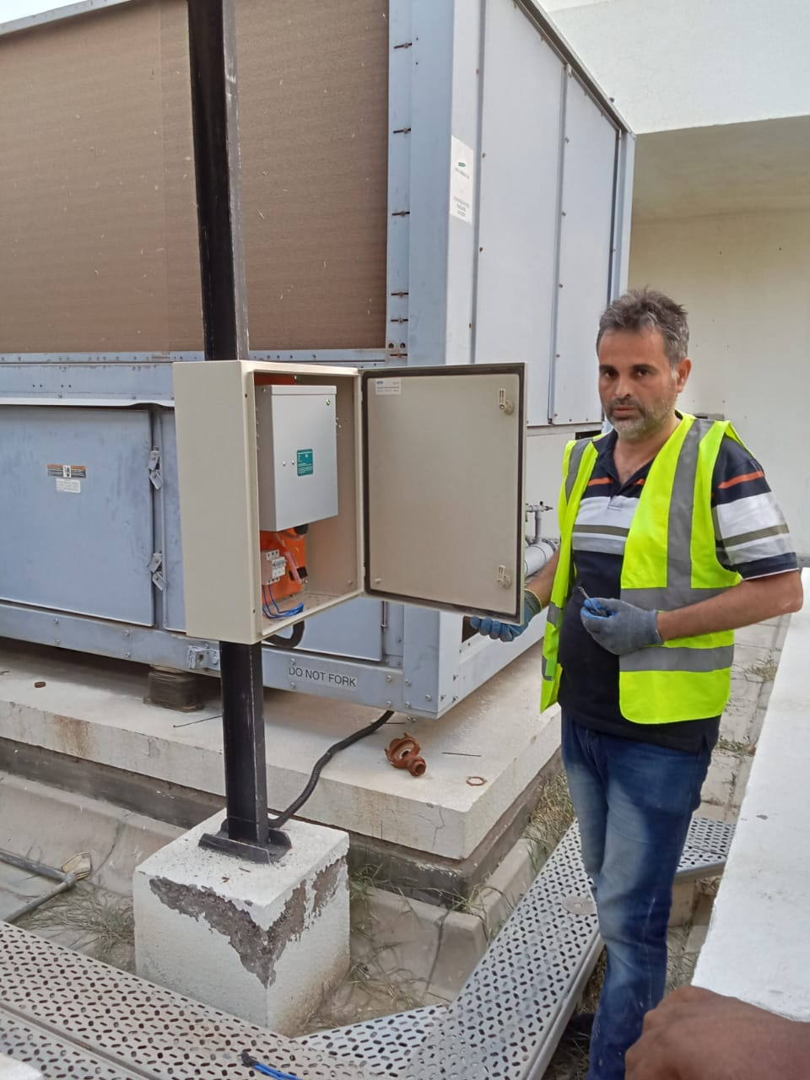
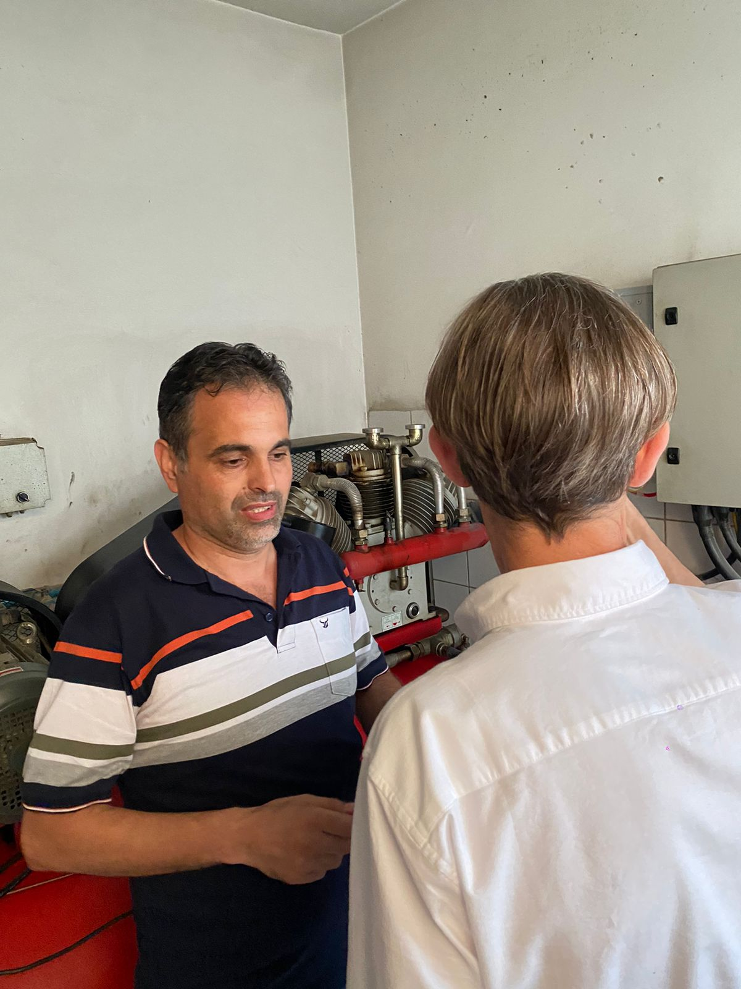

Slide 8
Aims
we in Alshabka set our goal to maintain professional competence in offering complete solutions at an optimum level of quality and safety.
Targeting objectives that we strive to achieve and maintain :
1. To maintain a constant growth rate.
2. To offer complete solutions to the customer's electronic and electric requirement.

Slide 9
3. To guarantee customer satisfaction by following the devoted excellence and time schedule in all the projects.
4. To maintain honesty, integrity and professionalism in all the operations.
5. To have clients as Loyal customers.

Slide 10
Our values:
Commitment, attention to detail, and the pursuit of excellence appear as follows:
Quality for material and Work
Completion Projects in time
Customer Satisfaction

Slide 11
Mission and vision
Our scope of work. to move forward with a focus on safety in any work we take up. Offering Eco-friendly solutions to our clients endless Vision for future to Leading contractual services in design, installation, testing Automation and Solar and other Renewable energy controlling system

Slide 12
Specification
Electrical & Low Current Works We are specialized in installation and maintenance of all kinds of Electrical, Power & Lighting works. If you are looking for highly Efficient and cost-effective electrical works for your home, building or place of work, we are your best choice.
We offer a wide range of services from simple electrical wiring works to more complex installation

Slide 13

Our Services
EMERGENCY LICIANE
Call us (0527251415) for Fast services and we will arrange an onsite check &solve as soon as possible

Slide 14

Lighting DESIGN
No matter if it’s in a room, office or outdoor area. We have experience in lighting design as well as installation.

Slide 15

SWITCHBOARD UPGRADE
Your expensive electronic equipment and gadgets may be at risk to an unexpected power surge.

Slide 16

ALARM & cctv SYSTEMS
We provide installation and maintenance on a range of alarm systems, security systems, and CCTV systems

Slide 17

ELECTRICAL TESTING
We diagnose electrical faults fast. If you have problems relating to electrical wiring or lighting we can help.

Slide 18

INSTALLATIONS DESIGN
We complete the design of electrical installations and provide electrical engineering in LV

Slide 19

SMART HOME
Some smart home devices allow you to protect your home but also to save energy and money.

Slide 20
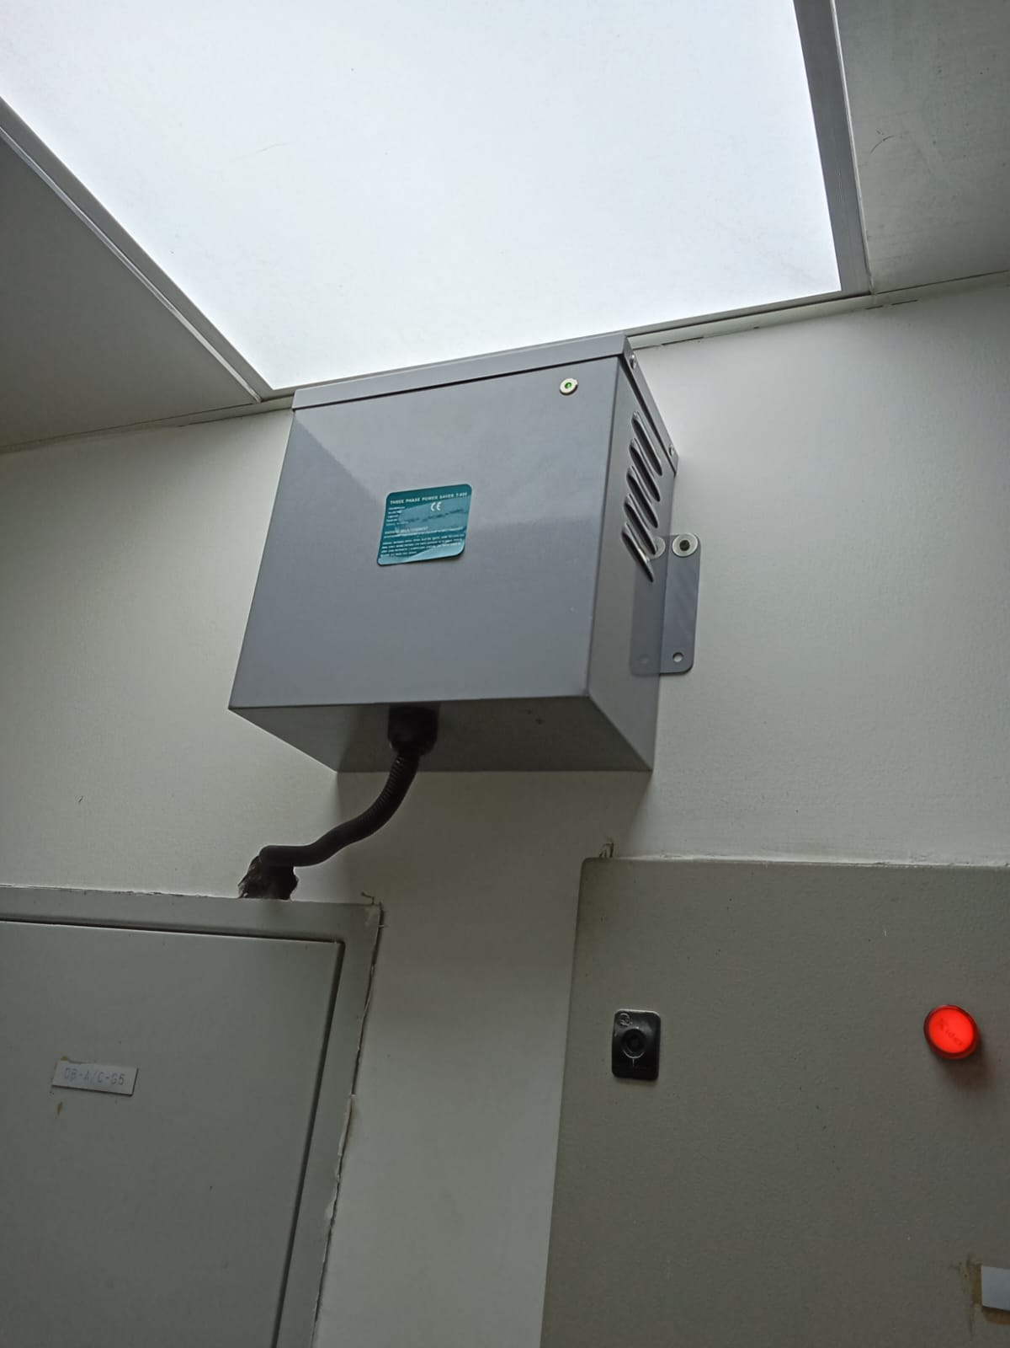
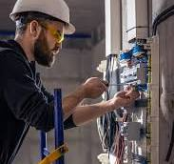
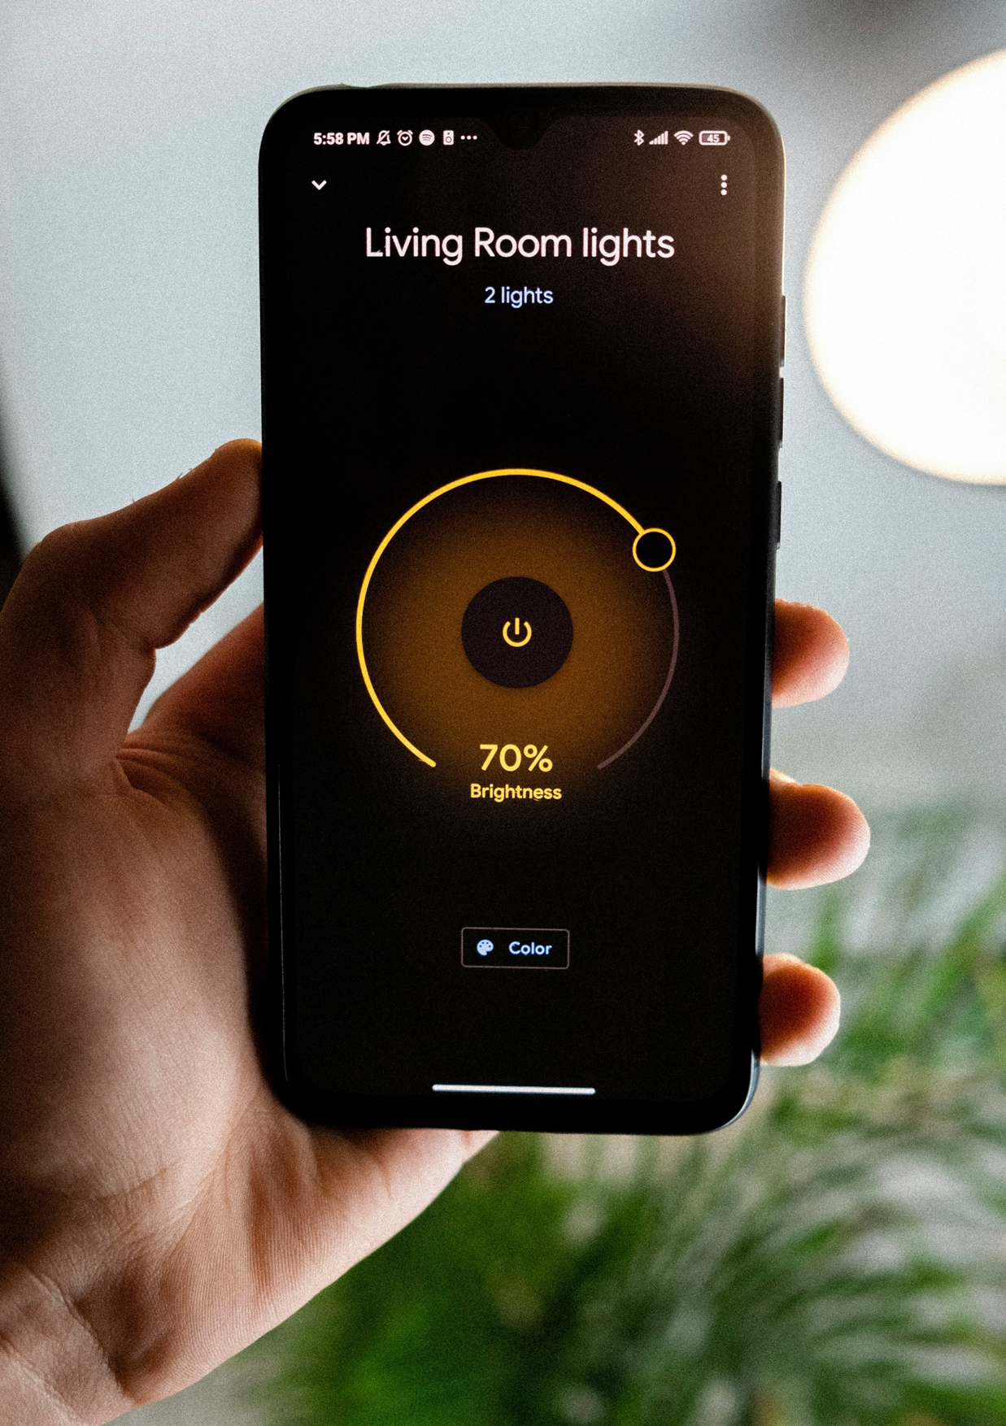
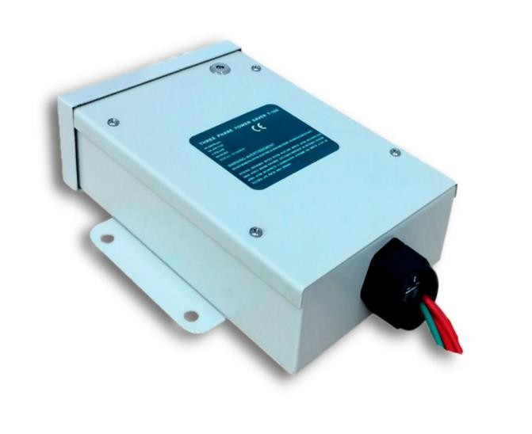

Slide 21

HOME AUTOMATION
Home automation is connecting various devices and systems in the home together so that they can all be controlled from anywhere, and creating the required interaction between them

Slide 22


We are open for collaboration and partnership with Corporations and companies in same field

Slide 23








Contact @ reach us

